Slide 1
Visualizing brain connectomics using D3.js
Brain Hack Open Geneva 2019
Renaud Marquis
EEG and Epilepsy Unit
Geneva University Hospital

Slide 2
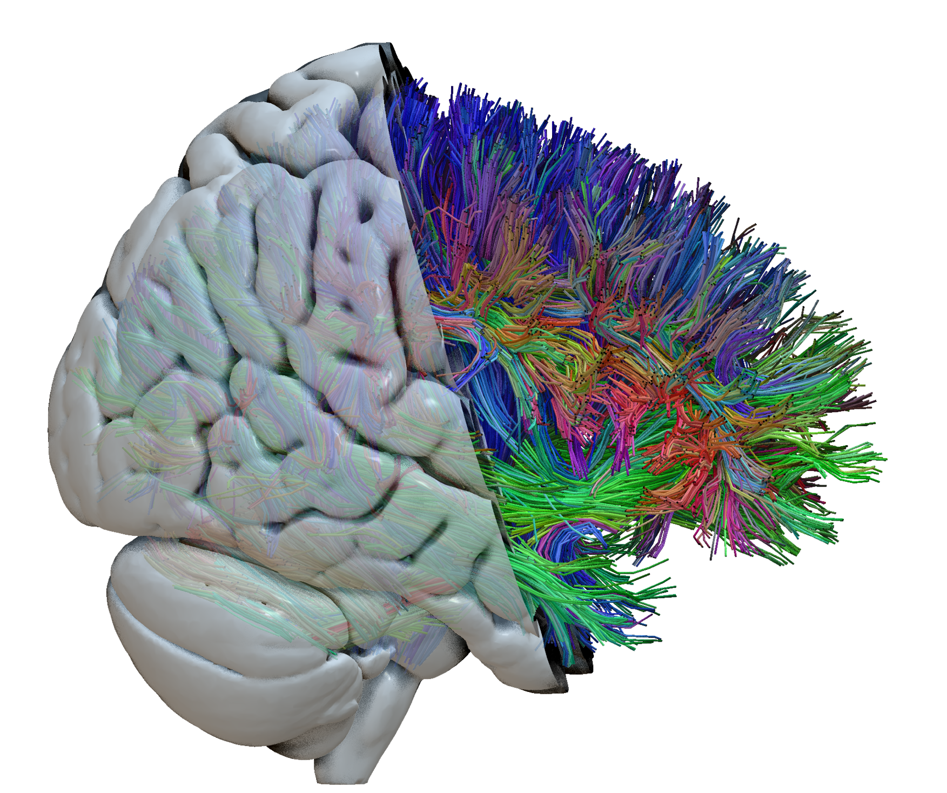
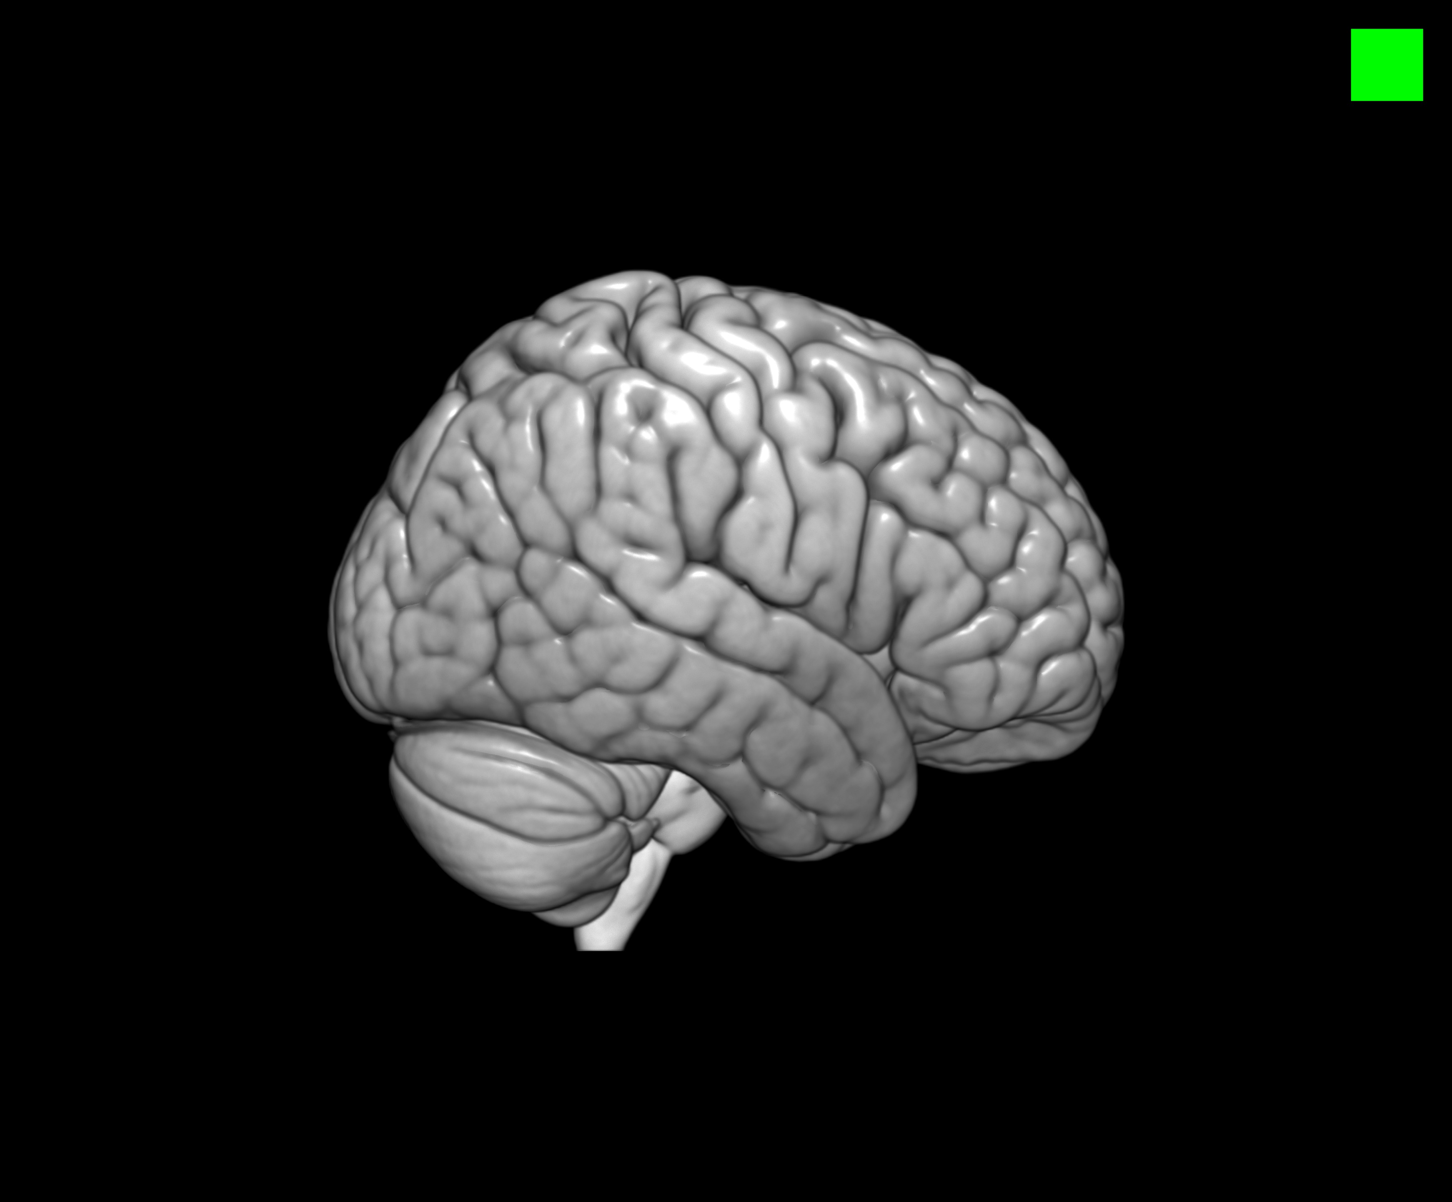
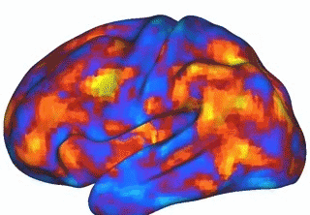
Structural and functional brain connectivity
100 billion neurons
Each neuron may be connected to up to 10,000 other neurons
1,000 trillion synaptic connections
Equivalent to a computer with a trillion bit / s processor

Slide 3
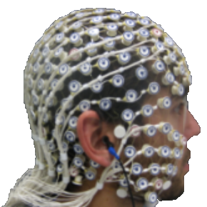
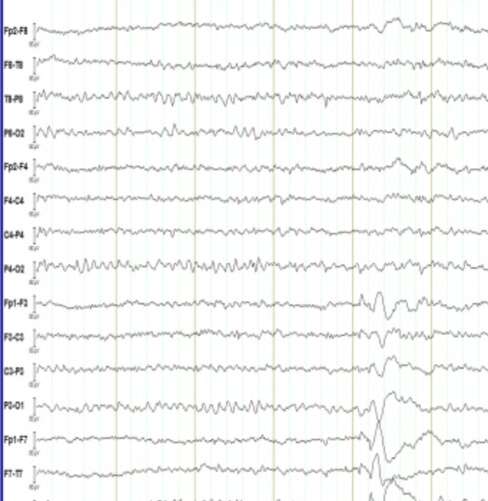
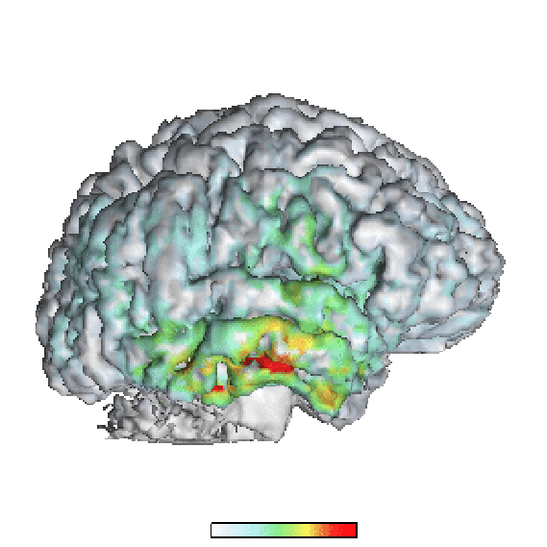
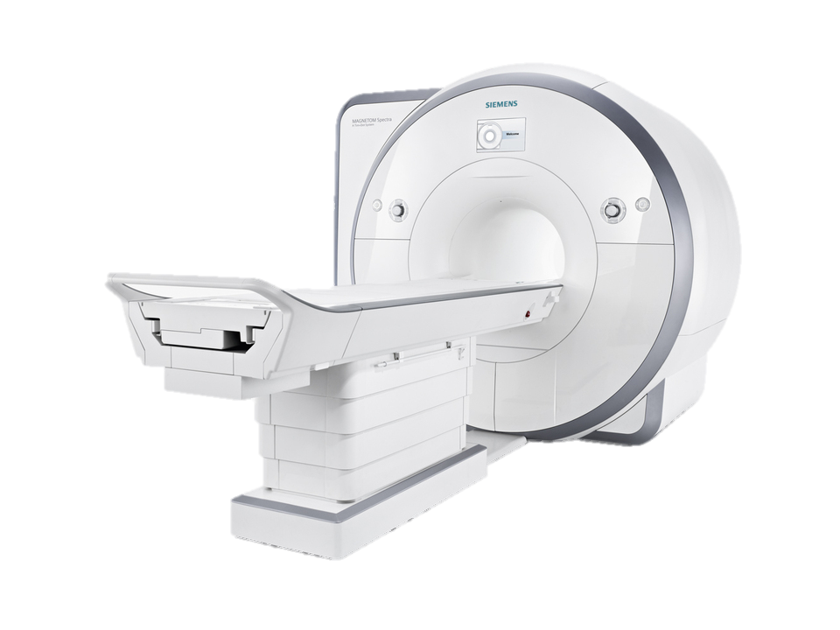
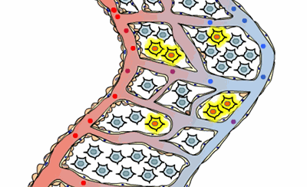
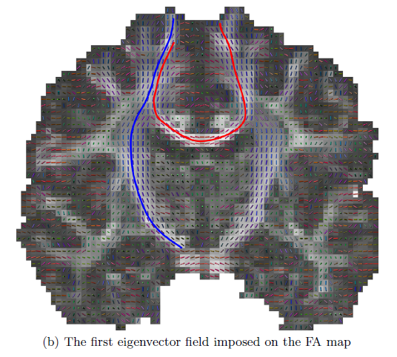
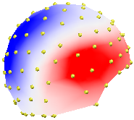
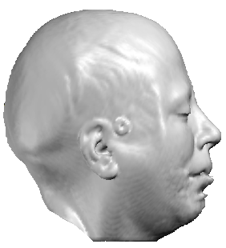
Imaging methods
EEG
Functional MRI
Diffusion MRI

Slide 4

The need for visualization tools…

Slide 5
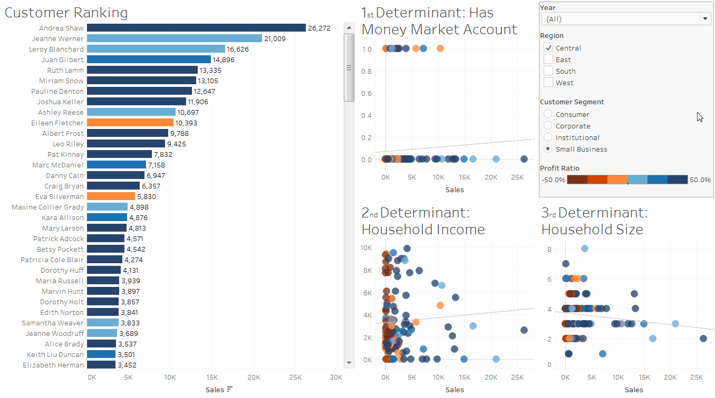
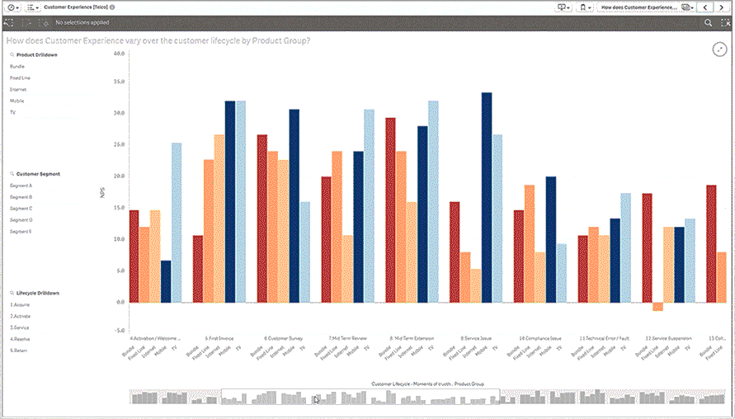
Commercial solutions

Slide 6
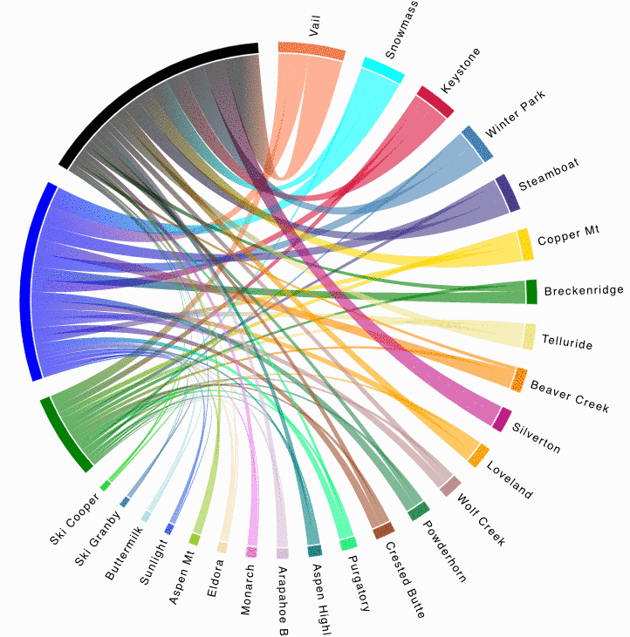
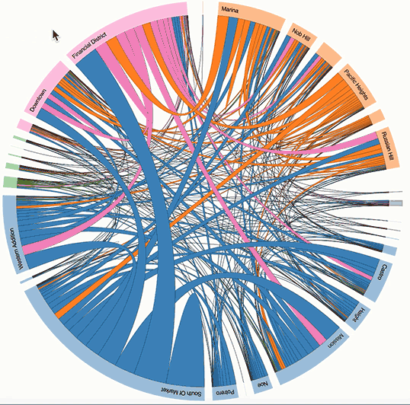
Existing chord diagrams in D3.js

Slide 7
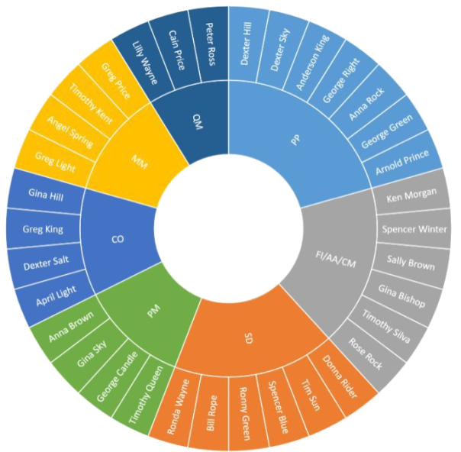
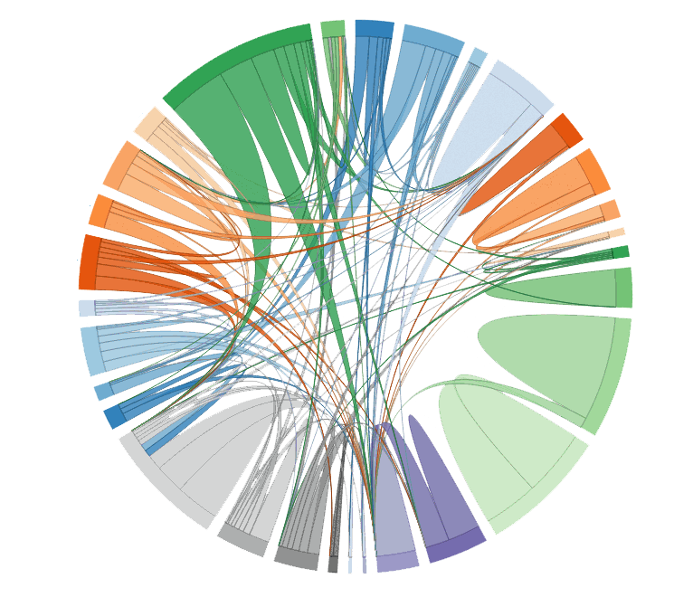
Chord diagram + sunburst

Slide 8
Multi-level chord diagram for each imaging modality
EEG
fMRI
DWI

Slide 9
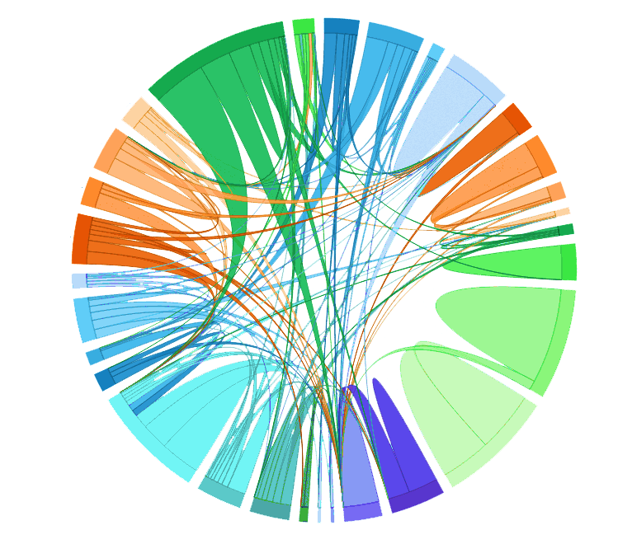
Drop-down menus for threshold & metrics
0.7
Threshold
Fiber density
Drop-down menu for diffusion metrics
10 Hz
Drop-down menu for EEG frequency bands

Slide 10
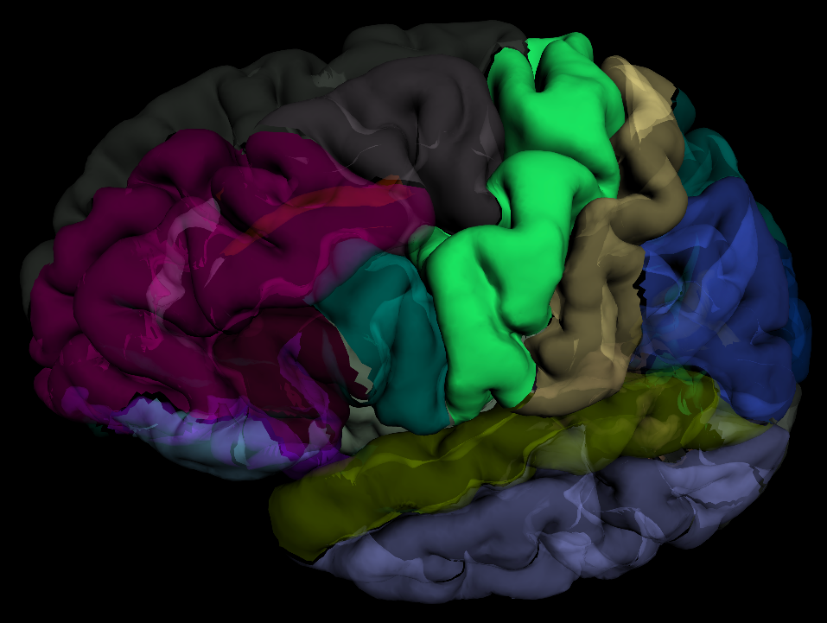
Region rendering using ROYGBIV or similar

Slide 11
… Join me to hack it! Thank you for your attention

Slide 12
Images credits and sources
sinergiaconsortium.bitbucket.io
www.informationisbeautifulawards.com/showcase/1019-d3-js
thisisnthappiness.com/post/67337544012/wheres-your-head-at
makeagif.com/gif/spontaneous-brain-activity-i-AK2jEh
www.mccauslandcenter.sc.edu/mricrogl
neuroscience5e.sinauer.com/animations01.01.html
www.qlik.com/us/products
alexloth.com/2016/10/18/find-important-variables-determining-sales-tableau-r/
bost.ocks.org/mike/uberdata/
static1.squarespace.com/static/5878581a9de4bbafa8af75d1/t/5914d0e246c3c49de287717b/1494536448667
roygbiv.mindboggle.info

